Slide 1
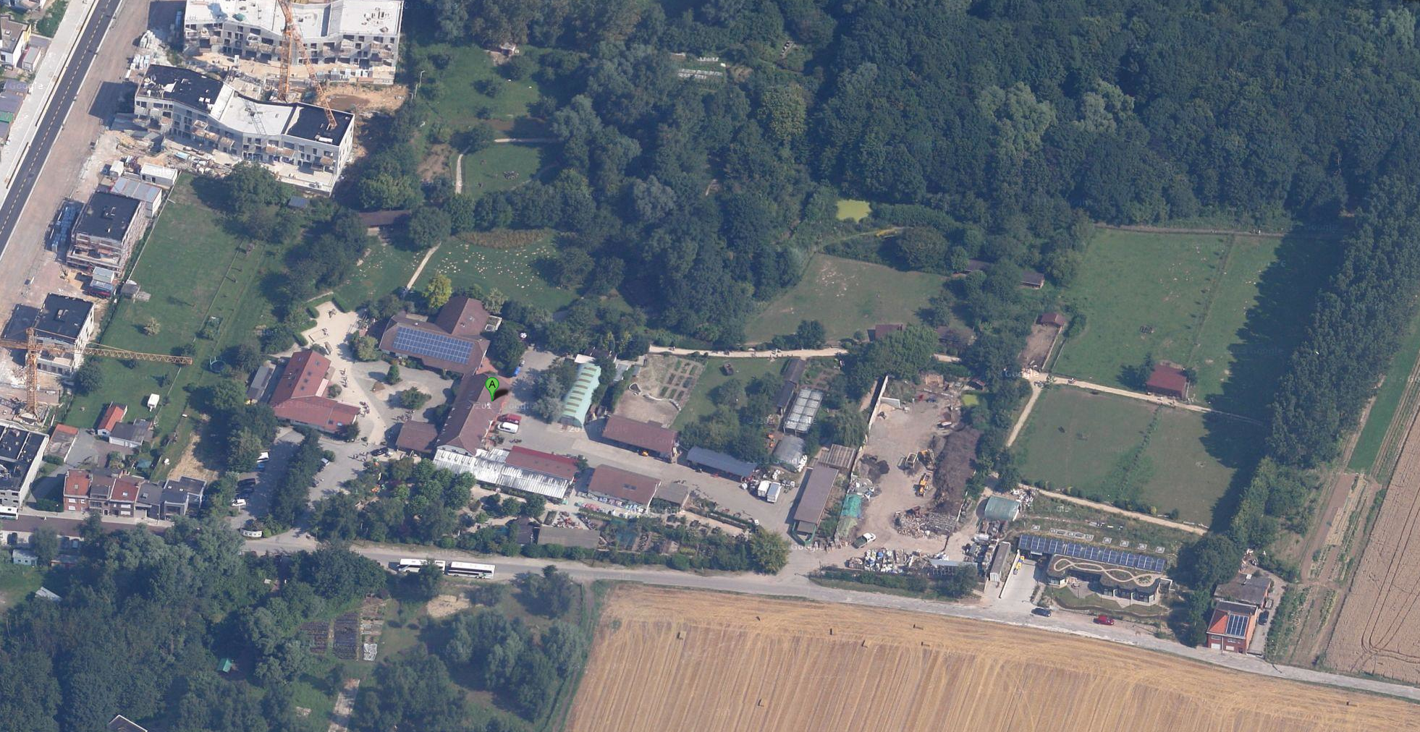
Bee hives
Animal park
Pond
Restaurant
Compost
Grocery store & bakery
Garden center
Handling work

Slide 10
Agroecology
Soil observance
Use of natural ennemies for integrated pest management
Support for pollinators

Slide 11
Wood ash
Animal fats
Use of natural and biodegradable phytosanitary products
Agroecology

Slide 12
Agroecology
Friendly labor for soil life and structure preservation

Slide 13
Water and energy saving
Agroecology

Slide 14
Agroecology
Use green manure, compost, natural fertilizers

Slide 15
Agroecology
Pedagogy

Slide 16
A tool for
social integration
Agroecology

